Slide 1

RUNGTA COLLEGE OF DENTAL SCIENCES & RESEARCH
TRAUMATIC INJURIES TO ANTERIOR TEETH
DEPARTMENT OF PEDODONTICS AND PREVENTIVE DENTISTRY

Slide 2
SPECIFIC LEARNING OBJECTIVES
Core areas | Domain
Introduction Etiology Classification Mechanism | Splinting Reimplantation Periodontal healing reaction

Slide 3
CATEGORY
MUST TO KNOW
NICE TO KNOW
Splinting
DESIRE TO KNOW
Periodontal healing reaction
Etiology
Mechanism
classification
Reimplantation

Slide 4
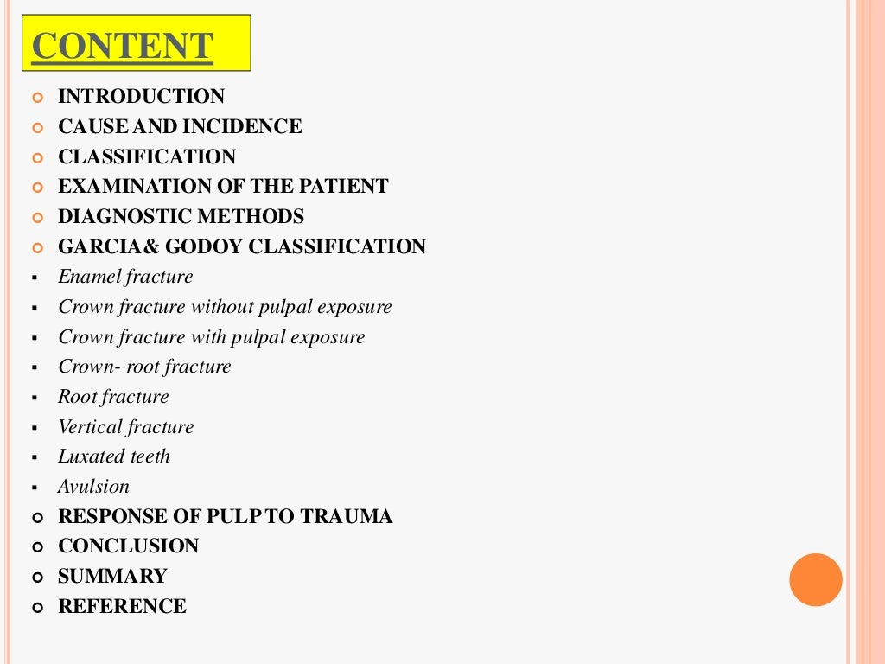

Slide 5
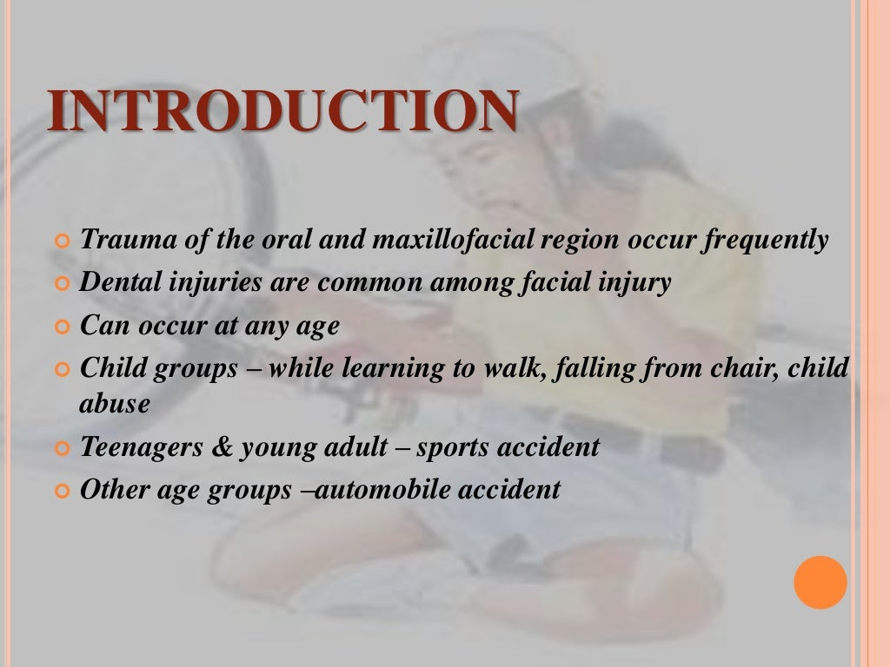

Slide 6
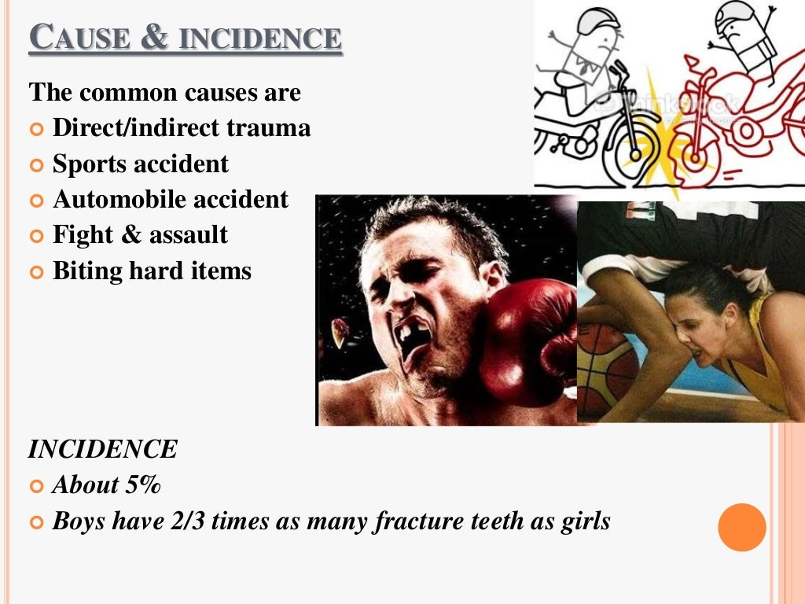

Slide 7
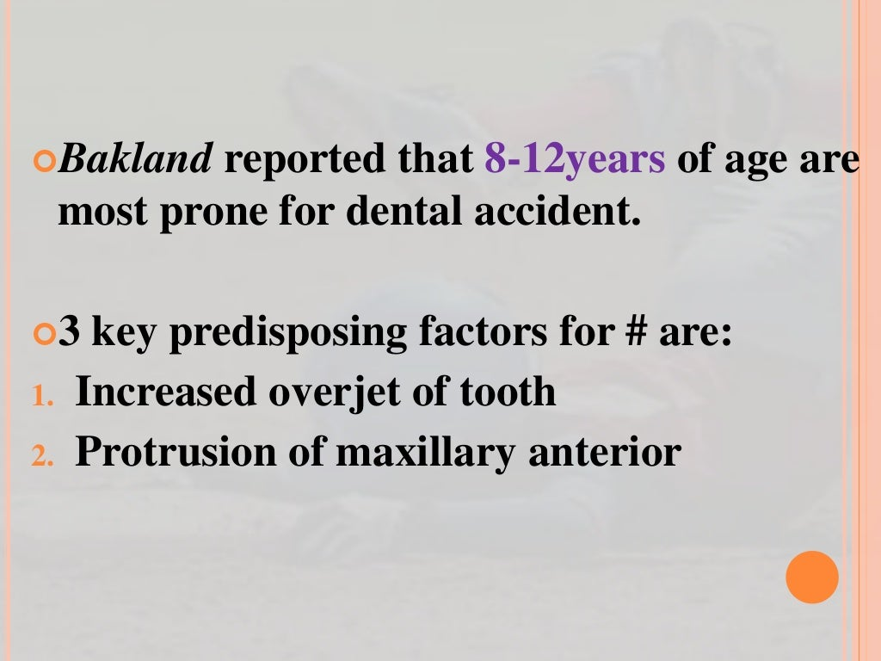

Slide 8
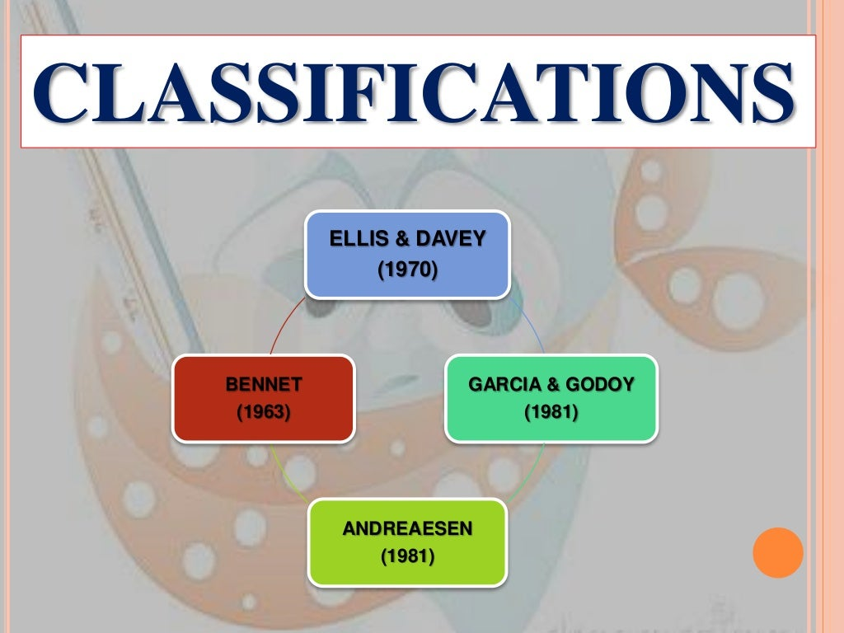

Slide 9
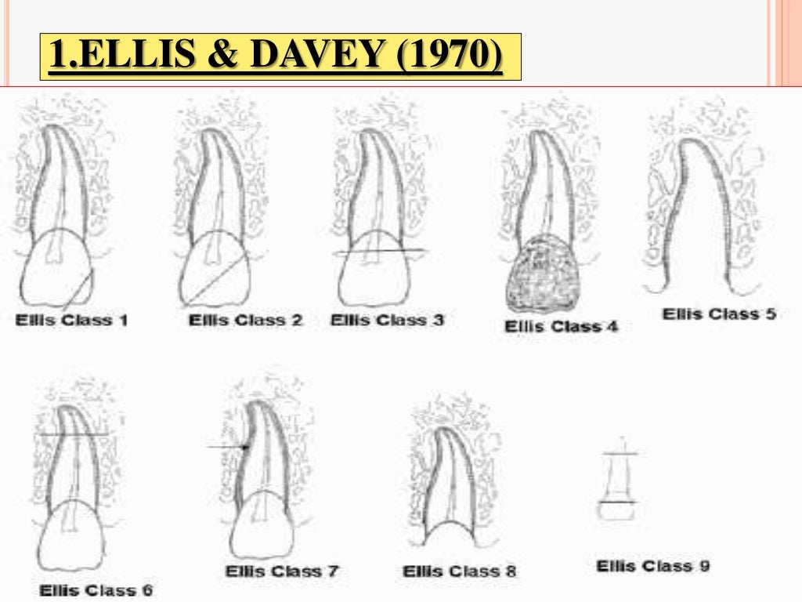

Slide 10
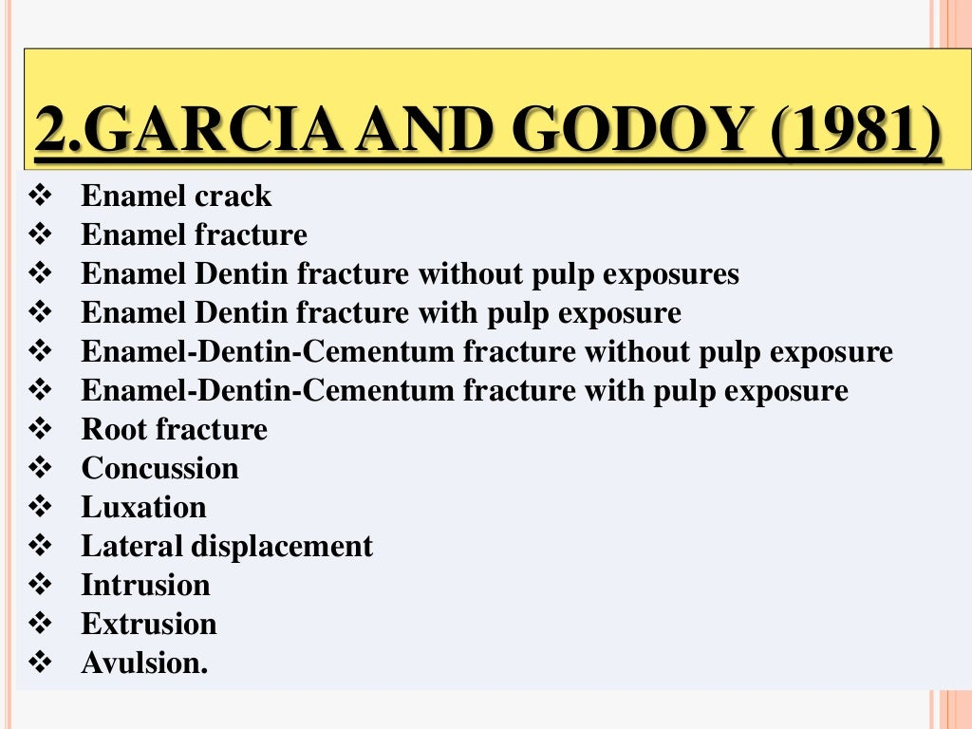

Slide 11
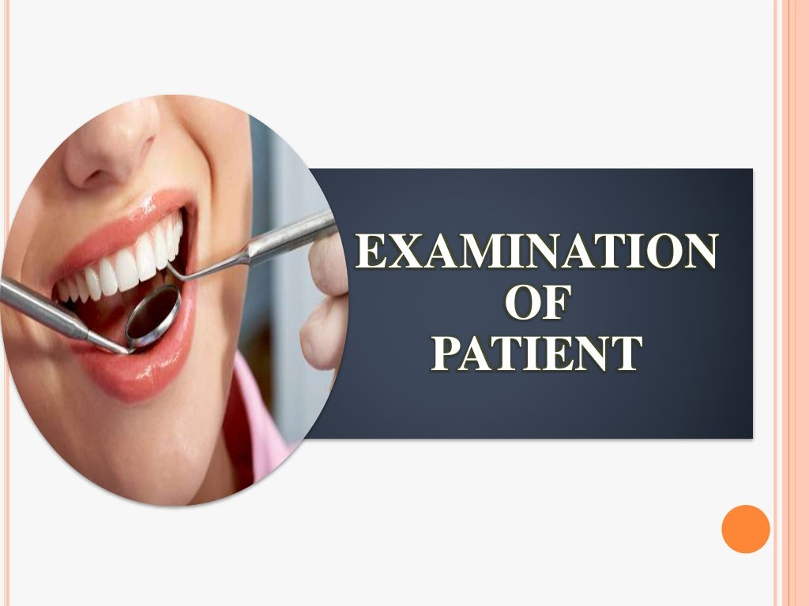

Slide 12
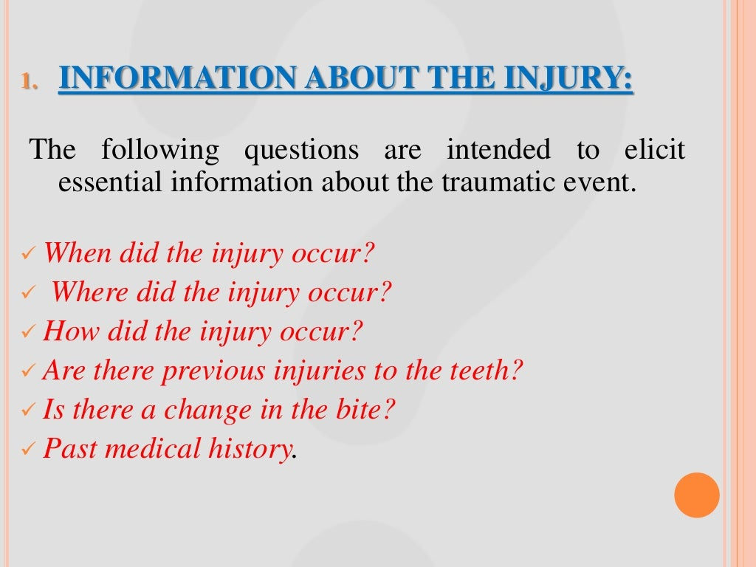

Slide 13
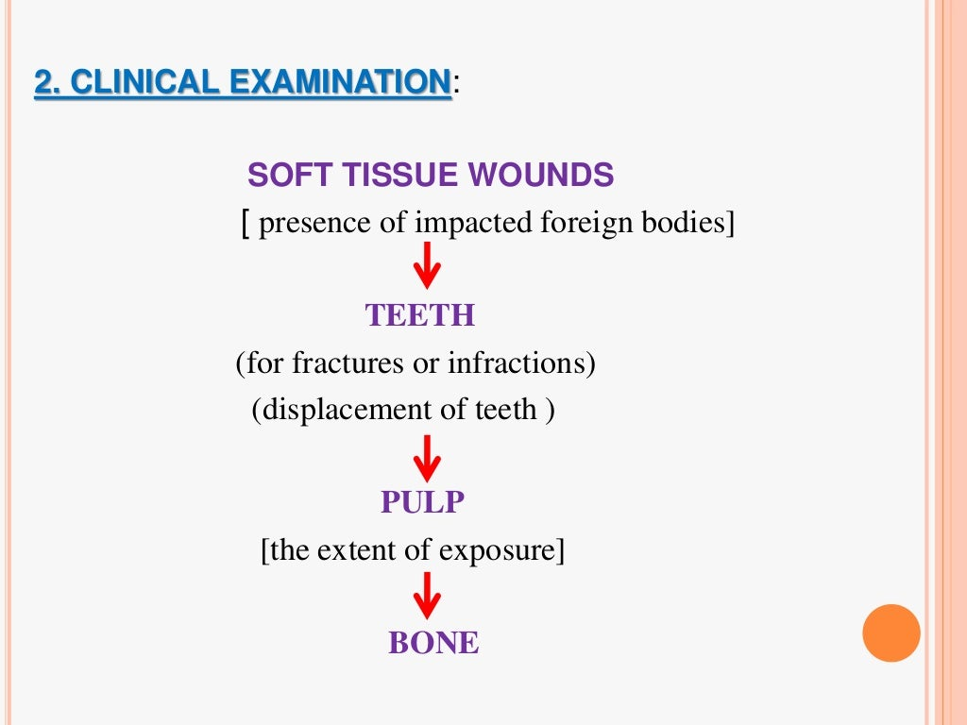

Slide 14
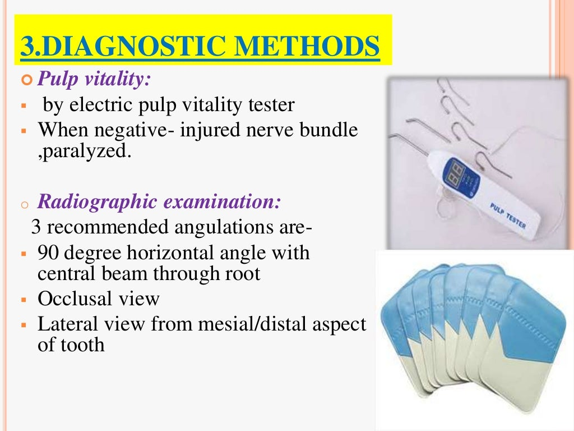

Slide 15
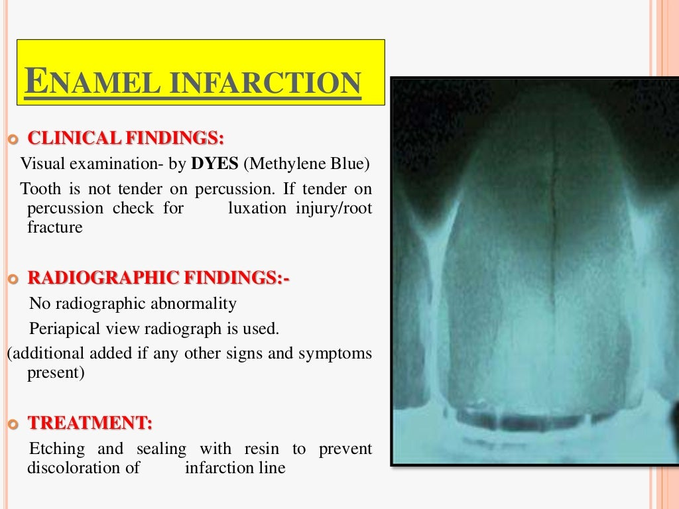

Slide 16
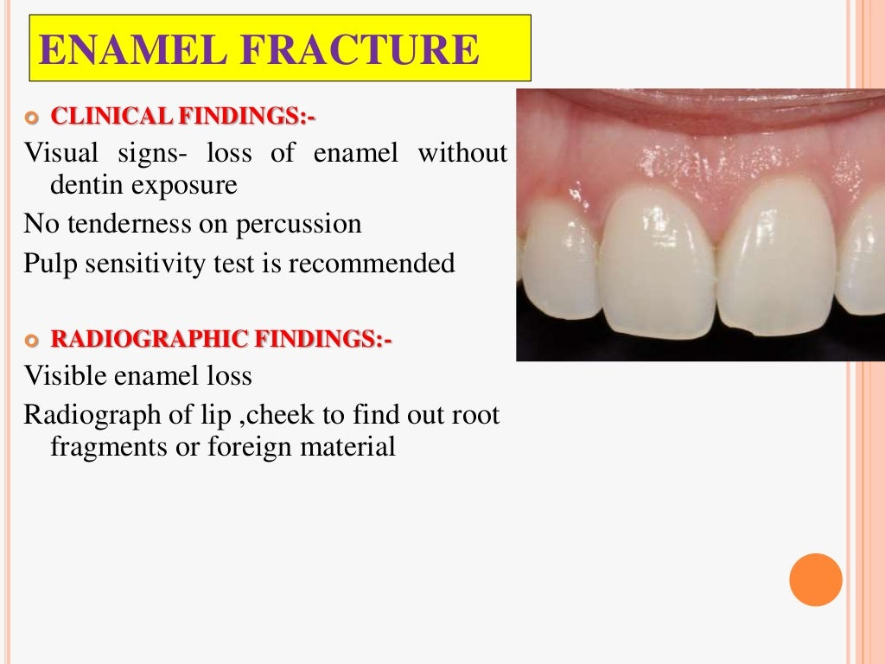

Slide 17
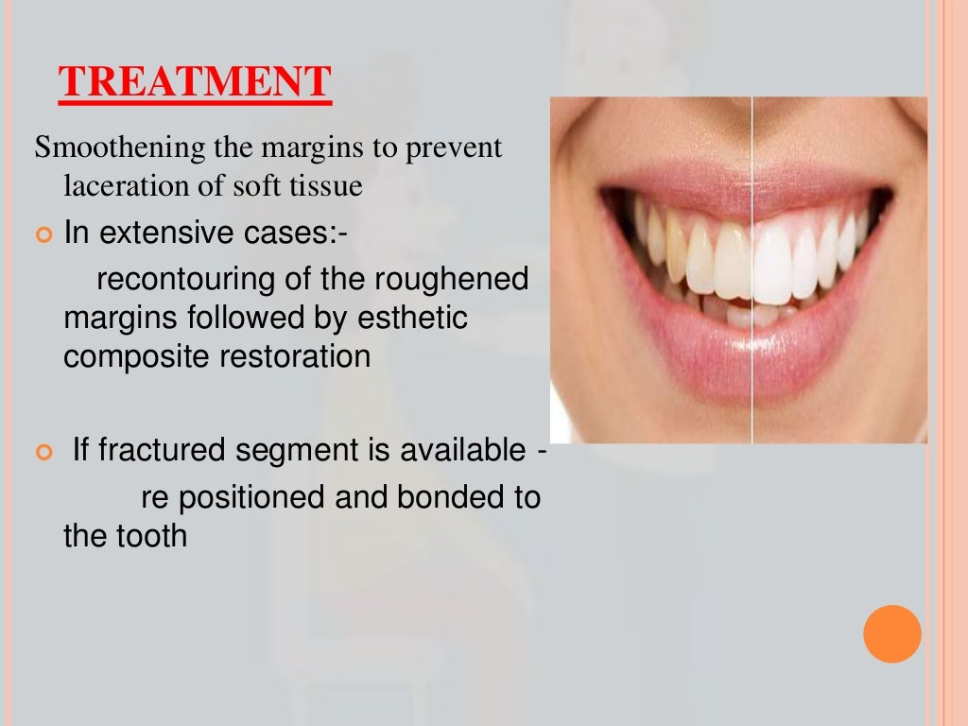

Slide 18
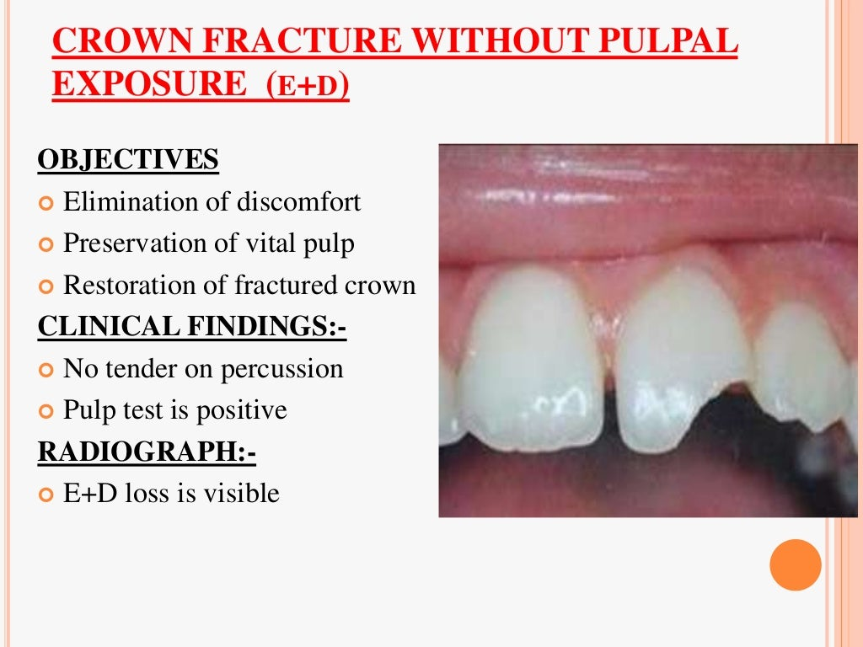

Slide 19
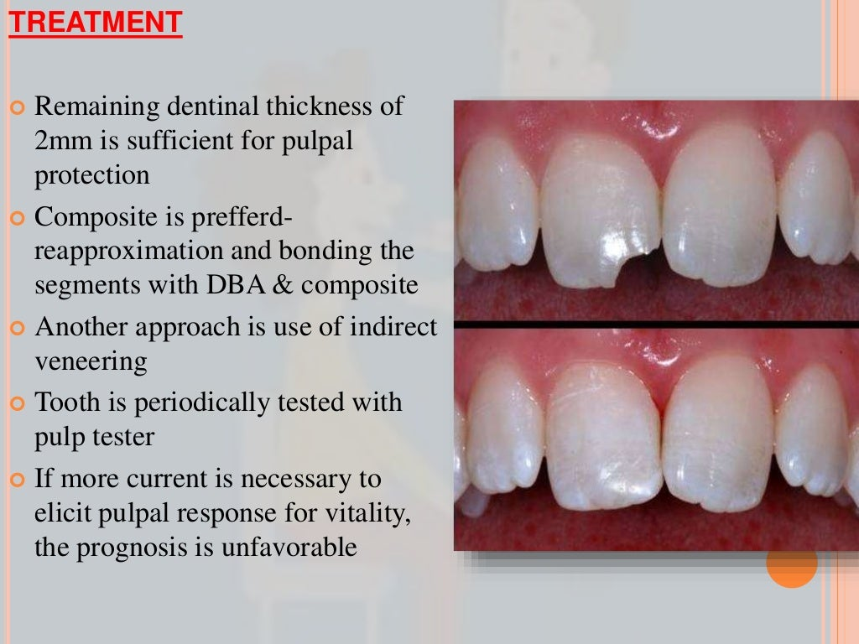

Slide 20
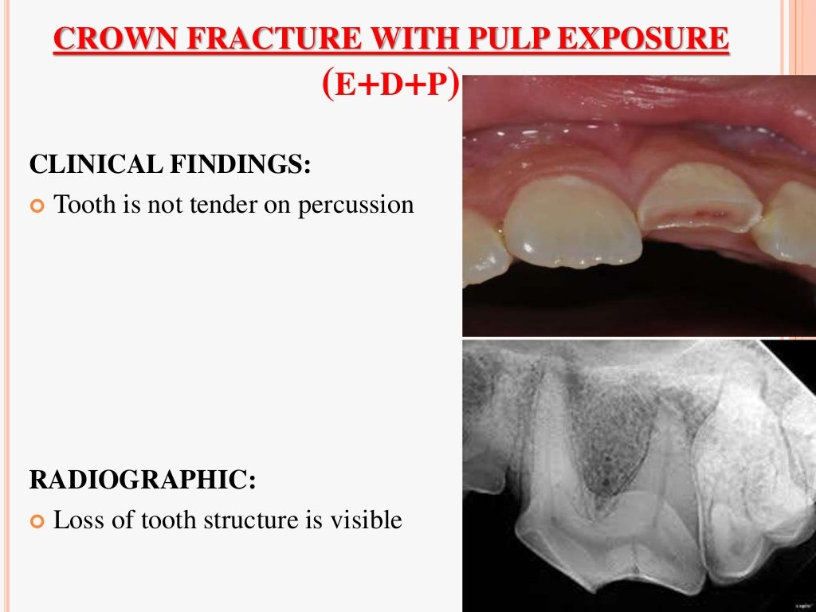

Slide 21
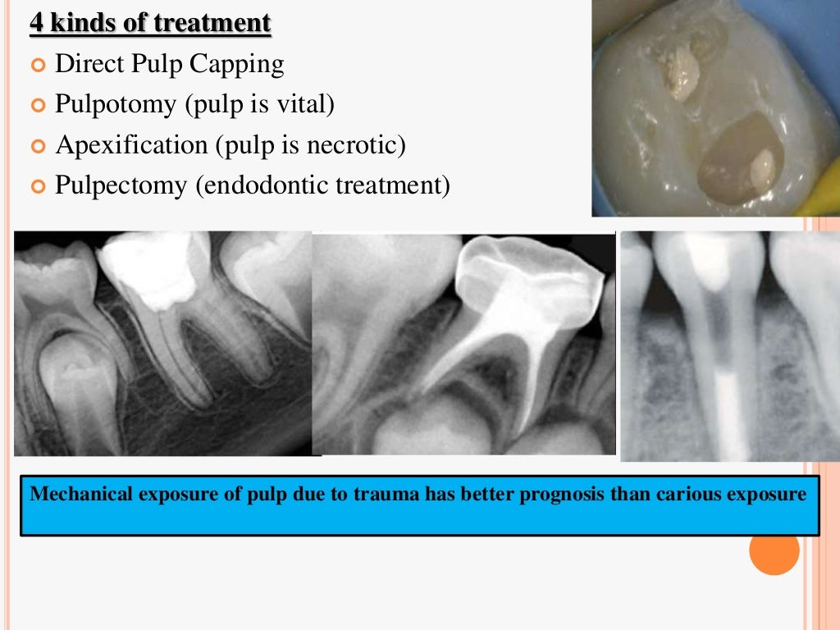

Slide 22
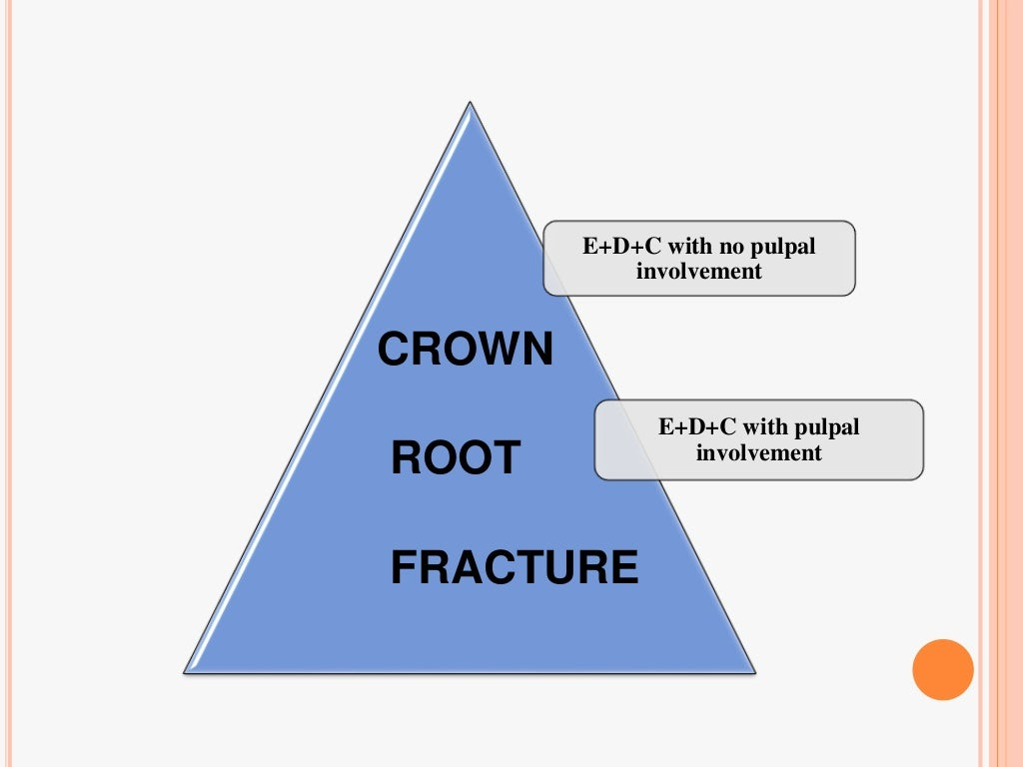

Slide 23
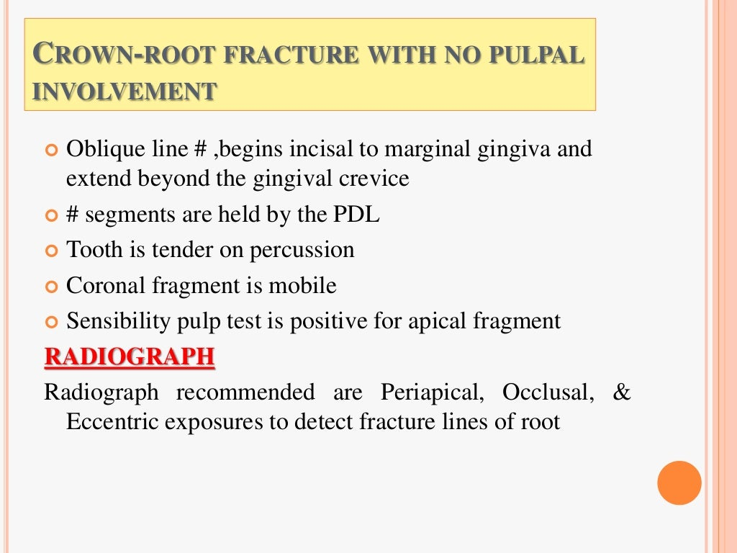

Slide 24
